Slide 1




Python AI Masterclass
UzDjangoDevelopers
Bedilbek Khamidov

Slide 2


About Instructor
https://www.linkedin.com/in/bedilbek/

Slide 3
Artificial Intelligence

Slide 4

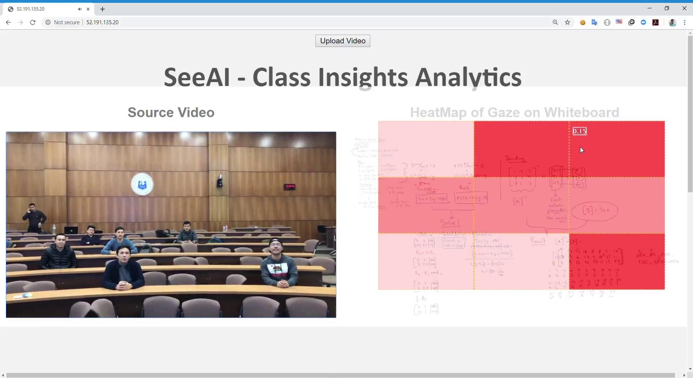
C-Vision
https://cvision.uz

Slide 5

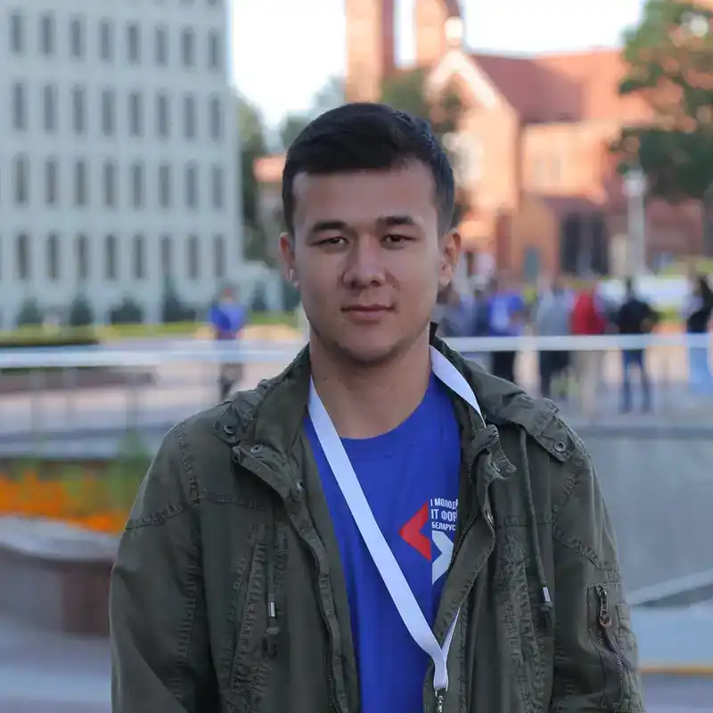

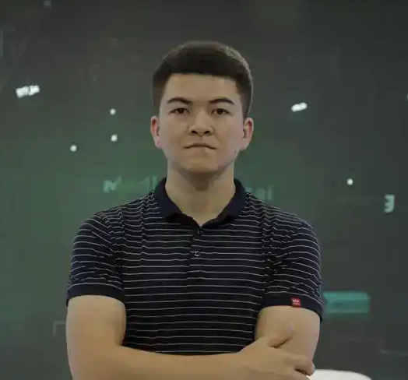

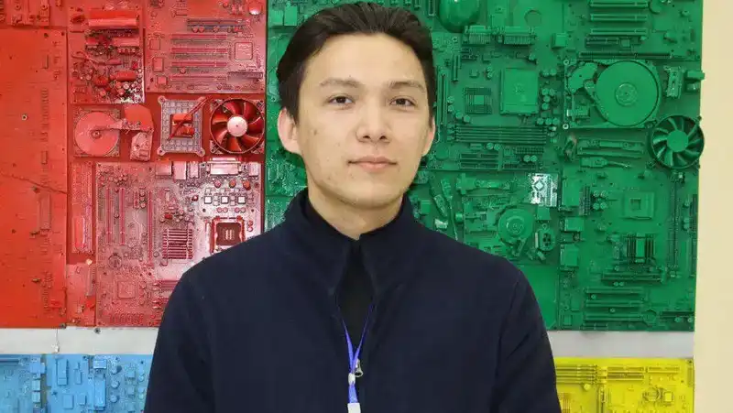
C-Vision Founders
Sardor Ibrokhimov
Shakhobiddin Urmanov
Sherzod Niyazov
Eldor Abdukhamidov
Abdullokh Askarov
https://raisense.uz

Slide 6
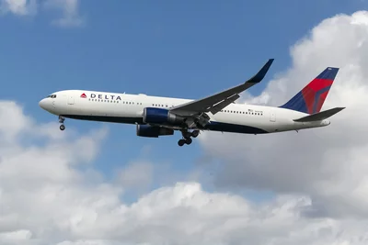
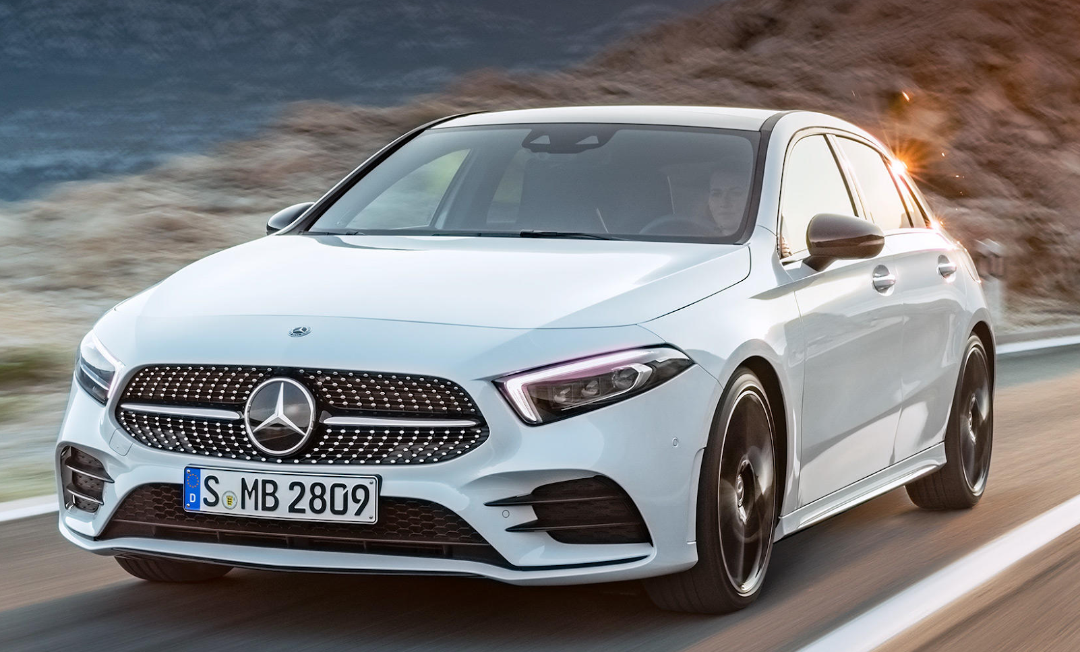
Multi-Class Image Classification
Plane
?
Car
[img_src][https://people.com/travel/inflatable-evacuation-slide-drops-from-delta-plane-into-massachusetts-mans-front-yard/]
[img_src][https://www.mercedes-benz.com/en/vehicles/passenger-cars/]

Slide 7
Artificial Intelligence
Machine Learning - to perform a specific task without using explicit instructions, relying on patterns and inference instead
Expert Systems
Planning
Robotics
Natural Language Processing
Artificial General Intelligence

Slide 8
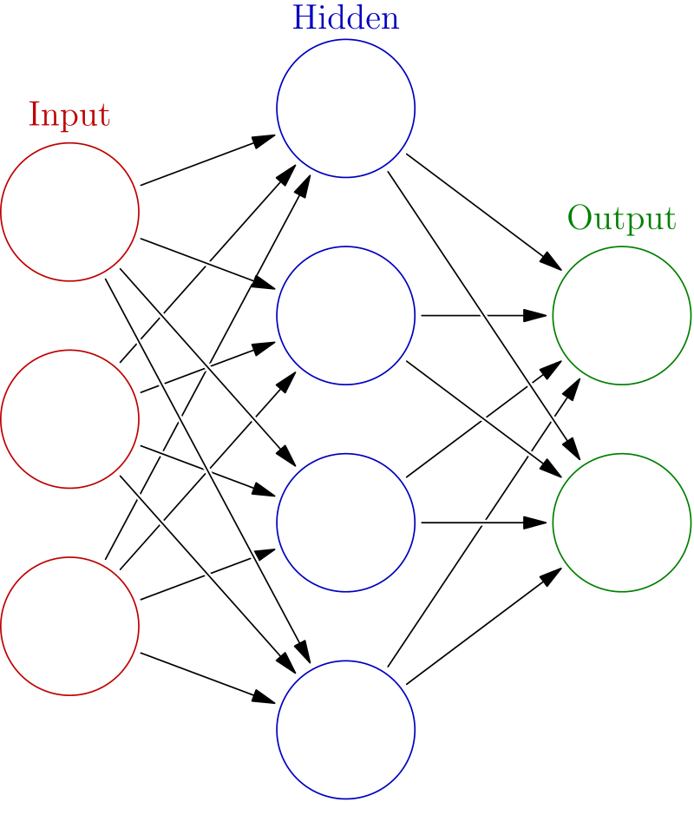

Machine Learning
Artificial Neural Network - inspiration by the biological neural networks that constitute animal brains
Clustering
Reinforcement Learning
[img_src][https://rpubs.com/ranvirkumarsah/Intro2ANN]
[img_src][https://upload.wikimedia.org/wikipedia/commons/thumb/1/10/Blausen_0657_MultipolarNeuron.png/1920px-Blausen_0657_MultipolarNeuron.png]

Slide 9
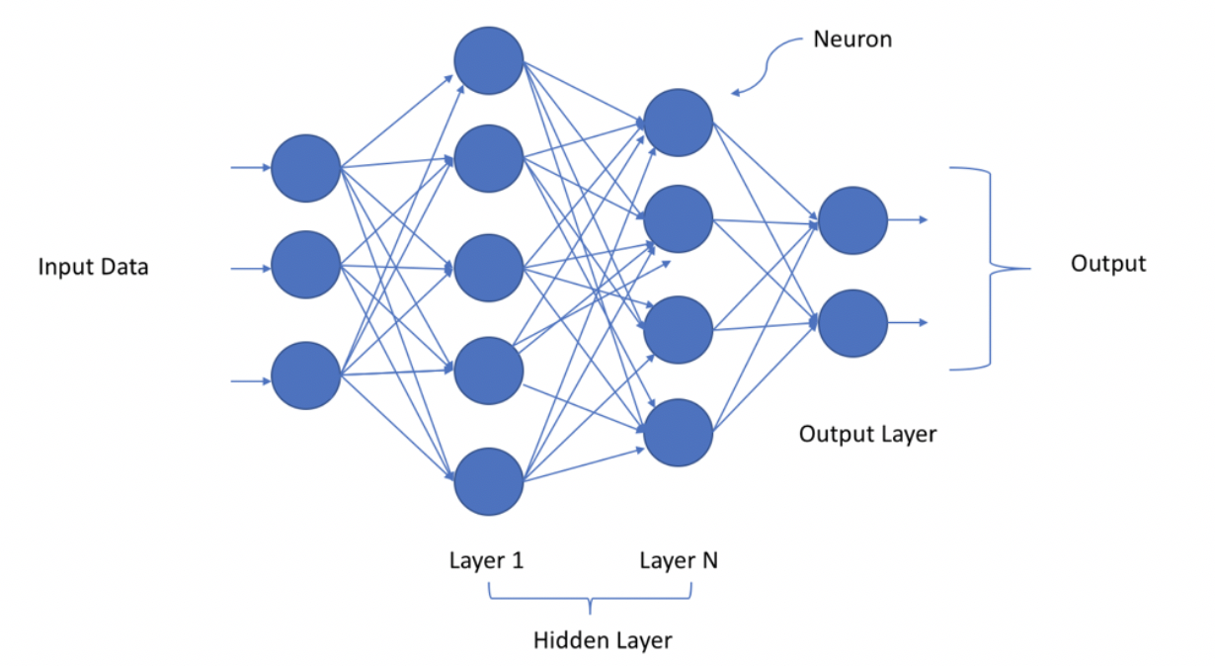
Aritifical Neural Network
Deep Neural Network (Deep Learning) - using multiple layers to progressively extract higher level features from the raw input
[img_src][https://towardsdatascience.com/a-laymans-guide-to-deep-neural-networks-ddcea24847fb]

Slide 10
Deep Learning
Supervised - function that maps an input to an output based on example input-output pairs
Multi-Class Image Classification
Semi-supervised
Unsupervised

Slide 11
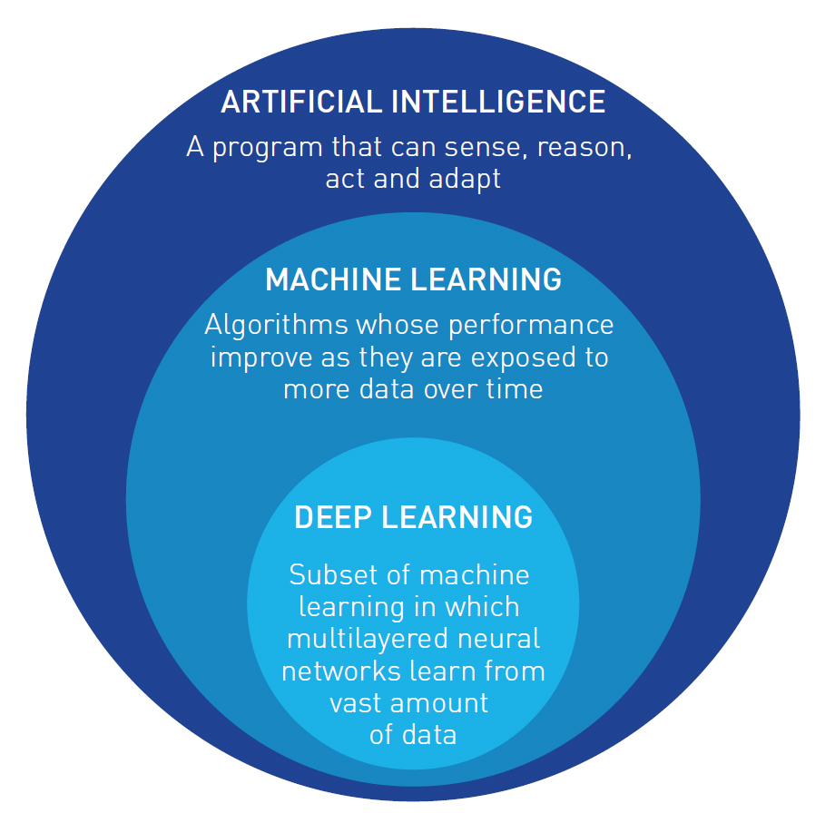
Artificial Intelligence
Multi-Class Image Classification
[img_src][https://www.sesarju.eu/node/3356]

Slide 12

Multi-class image classification
Convolutional Neural Network
[img_src][https://towardsdatascience.com/basics-of-the-classic-cnn-a3dce1225add]

Slide 13
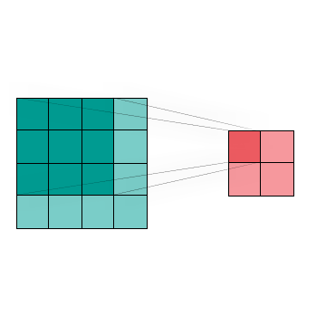
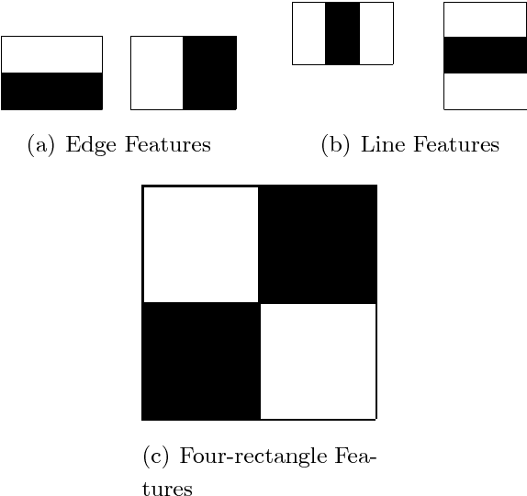
Image Convolution Layer
feature
image
[img_src][https://commons.wikimedia.org/wiki/File:Valid-padding-convolution.gif]
[img_src][https://www.semanticscholar.org/paper/A-Kernel-matching-approach-for-eye-detection-in-Vidal/a53a20b01e93f04a37e0ce74100a658d6443591a]

Slide 14
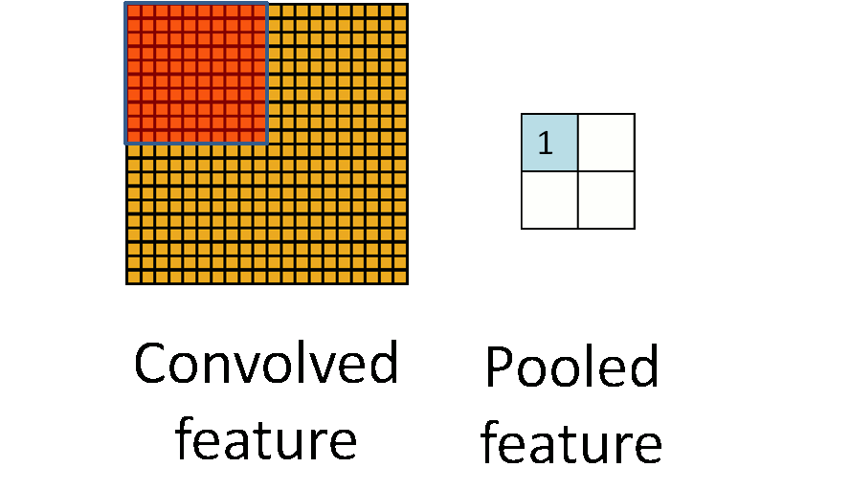
Image Pooling Layer
[img_src][https://hackernoon.com/visualizing-parts-of-convolutional-neural-networks-using-keras-and-cats-5cc01b214e59]

Slide 15
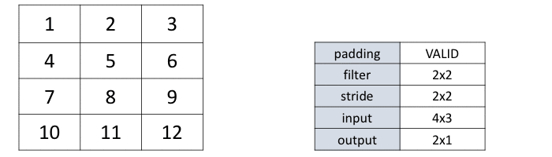
Image Pooling
Padding (valid)
[img_src][https://www.corvil.com/kb/what-is-the-difference-between-same-and-valid-padding-in-tf-nn-max-pool-of-tensorflow]

Slide 16
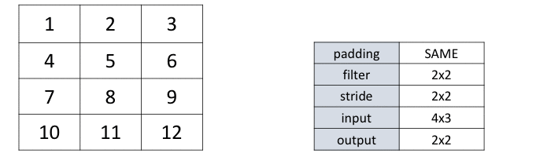
Image Pooling
Padding (same)
[img_src][https://www.corvil.com/kb/what-is-the-difference-between-same-and-valid-padding-in-tf-nn-max-pool-of-tensorflow]

Slide 17
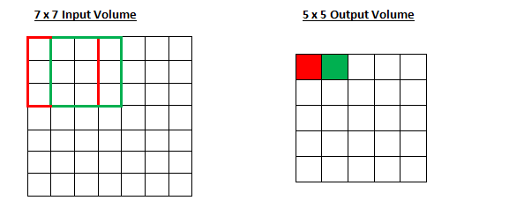
Image Pooling
Striding (1x1)
[img_src][https://www.corvil.com/kb/what-is-the-difference-between-same-and-valid-padding-in-tf-nn-max-pool-of-tensorflow]

Slide 18
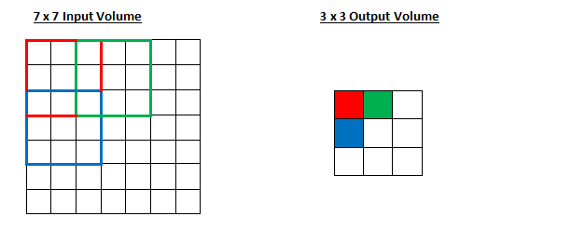
Image Pooling
Striding (2x2)
[img_src][https://adeshpande3.github.io/A-Beginner%27s-Guide-To-Understanding-Convolutional-Neural-Networks-Part-2/]

Slide 19

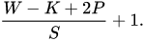
Image Pooling
striding (2x2 example)
[img_src][https://en.wikipedia.org/wiki/Convolutional_neural_network]

Slide 20

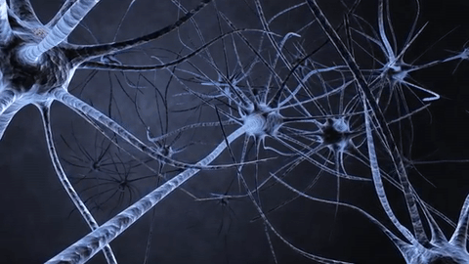
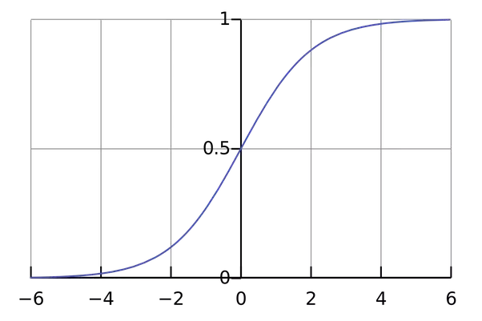
Activation Layer
Relu (Rectified Linear Unit)
[img_src][https://towardsdatascience.com/is-relu-reluvant-52b03bc48daa]
Softmax
[img_src][https://giphy.com/gifs/harvard-brain-neuron-9N2UvCx7wXLnG]
[img_src][https://www.quora.com/How-does-softmax-function
-work-in-AI-field]

Slide 21
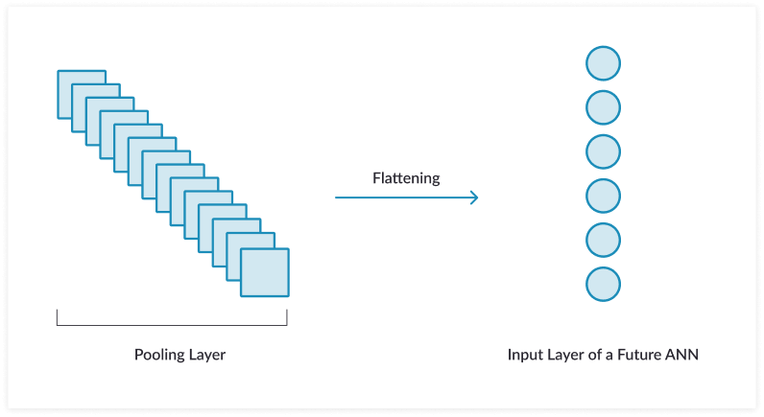
Flatten Layer
[img_src][https://missinglink.ai/guides/keras/using-keras-flatten-operation-cnn-models-code-examples/ ]

Slide 22
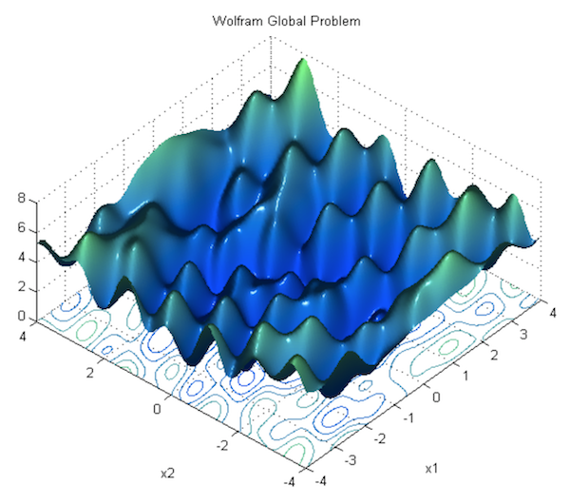
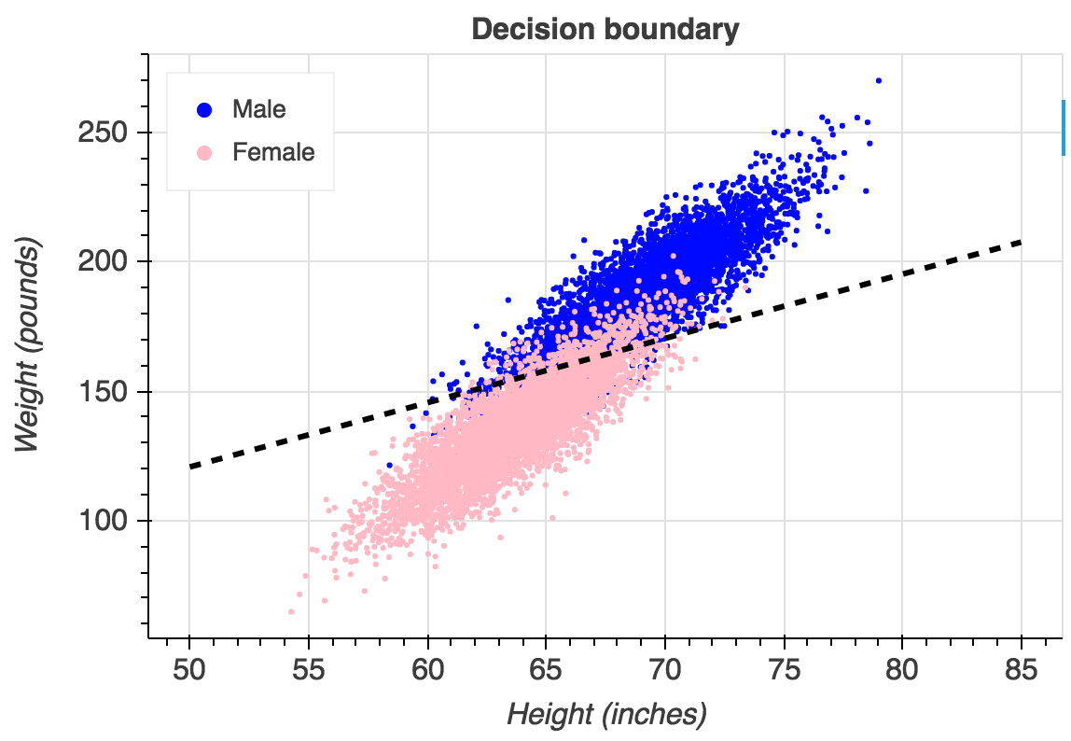
Neural Network Loss function
Categorical Cross Entropy
[img_src][https://towardsdatascience.com/understanding-logistic-regression-step-by-step-704a78be7e0a]
[img_src][https://towardsdatascience.com/neural-network-optimization-7ca72d4db3e0]

Slide 23
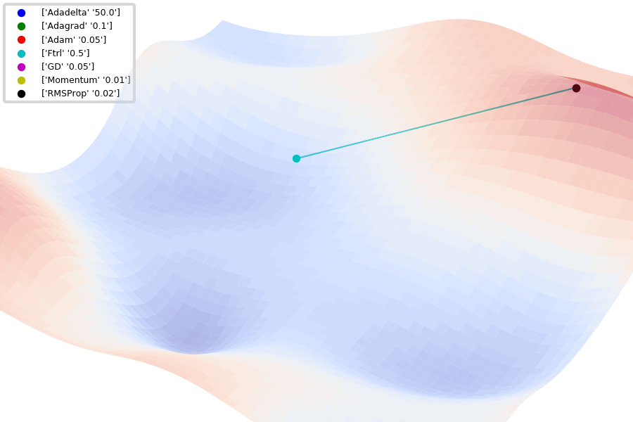
Neural Network Optimizer function
Adam
[img_src][https://towardsdatascience.com/understanding-logistic-regression-step-by-step-704a78be7e0a ]
[img_src][https://github.com/Jaewan-Yun/optimizer-visualization]

Slide 24
Convolutional Neural Network
[img_src][https://towardsdatascience.com/basics-of-the-classic-cnn-a3dce1225add]

Slide 25


Python AI Libraries and Frameworks
TensorFlow
Keras

Slide 26

Masterclass Follow-Up Source Code Repository
https://github.com/bedilbek/image_classification_masterclass

Slide 27
References
https://www.javatpoint.com/subsets-of-ai
https://towardsdatascience.com/types-of-convolution-kernels-simplified-f040cb307c37
https://en.wikipedia.org/wiki/Artificial_intelligence
https://en.wikipedia.org/wiki/Machine_learning
https://en.wikipedia.org/wiki/Artificial_neural_network
https://en.wikipedia.org/wiki/Deep_learning
https://en.wikipedia.org/wiki/Supervised_learning
https://en.wikipedia.org/wiki/Convolutional_neural_network
https://missinglink.ai/guides/keras/using-keras-flatten-operation-cnn-models-code-examples/
https://machinelearningmastery.com/pooling-layers-for-convolutional-neural-networks/
https://towardsdatascience.com/deep-learning-for-image-classification-with-less-data-90e5df0a7b8e
https://towardsdatascience.com/multi-label-image-classification-with-neural-network-keras-ddc1ab1afede
https://adeshpande3.github.io/A-Beginner%27s-Guide-To-Understanding-Convolutional-Neural-Networks-Part-2/
https://www.corvil.com/kb/what-is-the-difference-between-same-and-valid-padding-in-tf-nn-max-pool-of-tensorflow

Slide 28
Resources for further development
https://tensorflow.org/tutorials - tensorflow examples
https://www.pyimagesearch.com/ - keras implementations
https://www.coursera.org/learn/machine-learning - free course
https://towardsdatascience.com/machine-learning/home - machine learning articles
https://docs.python.org/3.6/tutorial/interpreter.html

Slide 29
Thank you for your attention

